Slide 1
Semantic Kernel Foundational Workshop
Plugins, planners, and personas.

Slide 2


Copilot definition
What is Semantic Kernel?
Semantic Kernel is a lightweight open-source SDK that lets you orchestrate native code with LLMs.
Semantic Kernel
Notes:
With Semantic Kernel, developers can leverage their existing skills and investments while unlocking the potential of AI-driven capabilities in their apps.

Slide 3
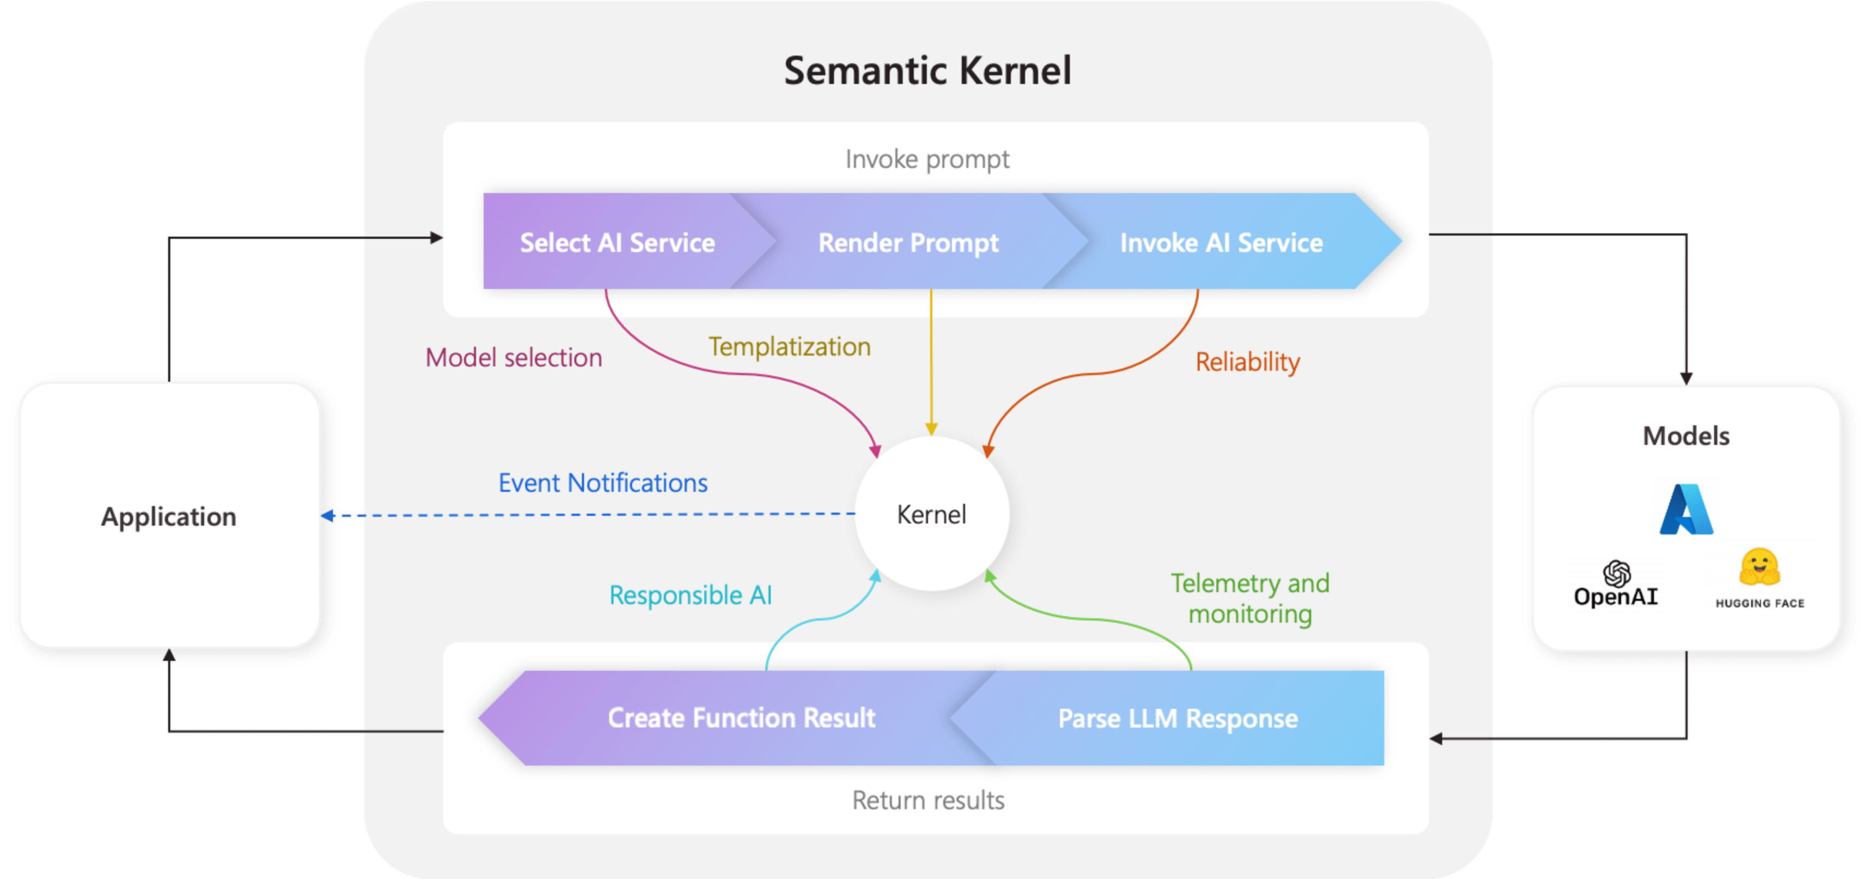
Copilot definition
The kernel is at the center of it all
Notes:
The kernel is the central component of Semantic Kernel. At its simplest, the kernel is a Dependency Injection container that manages all of the services and plugins necessary to run your AI application.
Because the kernel has all of the services and plugins necessary to run both native code and AI services, it is used by nearly every component within the Semantic Kernel SDK to power your agents. This means that if you run any prompt or code in Semantic Kernel, the kernel will always be available to retrieve the necessary services and plugins.

Slide 4
Copilot definition
Semantic Kernel is available in…
C#
Python
Java
Check out the documentation for details on the features supported in each language
Check here for latest news on SK

Slide 5
Copilot definition
Semantic Kernel at a high-level
How does Semantic Kernal Orchestrate AI?
Notes:
Semantic Kernel enables the integration of multiple AI models, plugins, and memory, resulting in the creation of advanced pipelines that automate intricate tasks for users.

Slide 6
Understanding Kernel Pipeline/Chain
Step | Component | Description
1 | Ask | It starts with a goal being sent to Semantic Kernel by either a user or developer.
2 | Kernel | The kernel orchestrates a user's ask. To do so, the kernel runs a pipeline / chain that is defined by a developer. While the chain is run, a common context is provided by the kernel so data can be shared between functions.
2.1 | Memories | With a specialized plugin, a developer can recall and store context in vector databases. This allows developers to simulate memory within their AI apps.
2.2 | Planner | Developers can ask Semantic Kernel to auto create chains to address novel needs for a user. Planner achieves this by mixing-and-matching plugins that have already been loaded into the kernel to create additional steps. This is similar to how ChatGPT, Bing, and Microsoft 365 Copilot combines plugins together in their experiences.
2.3 | Connectors | To get additional data or to perform autonomous actions, you can use out-of-the-box plugins like the Microsoft Graph Connector kit or create a custom connector to provide data to your own services.
2.4 | Custom plugins | As a developer, you can create custom plugins that run inside of Semantic Kernel. These plugins can consist of either LLM prompts (semantic functions) or native C# or Python code (native function). This allows you to add new AI capabilities and integrate your existing apps and services into Semantic Kernel.
3 | Response | Once the kernel is done, you can send the response back to the user to let them know the process is complete.

Slide 7
Copilot definition
How do you actually develop with Semantic Kernel?
Notes:
There have been a lot of news, new models by the day, new concepts and lots of upcoming research.
It can be challenging knowing where to start ..

Slide 8
It all starts with understanding 3 key things…
Plugins
Planners
Personas
1
2
3

Slide 9
Plugins
The core building block for Copilots and AI driven applications.

Slide 10




What is a plugin?
Connect AI to the real world
ChatGPT
M365 Copilot
Bing
Your application
Chatbots are nice, but they aren’t useful to your users until they can interact with the real world by…
Retrieve data
Sending emails
Completing sales
Making orders
And more!
1
2
AI Plugins
3
4
5

Slide 11
What is a plugin?
Connect AI to the real world
ChatGPT
M365 Copilot
Bing
Your application
Chatbots are nice, but they aren’t useful to your users until they can interact with the real world by…
Grabbing data
Sending emails
Completing sales
Making orders
And more!
1
2
Each one of you already has an app our service that generates real value for customers. By making a plugin, you make it easier for users to use it.
AI Plugins
3
4
5

Slide 12
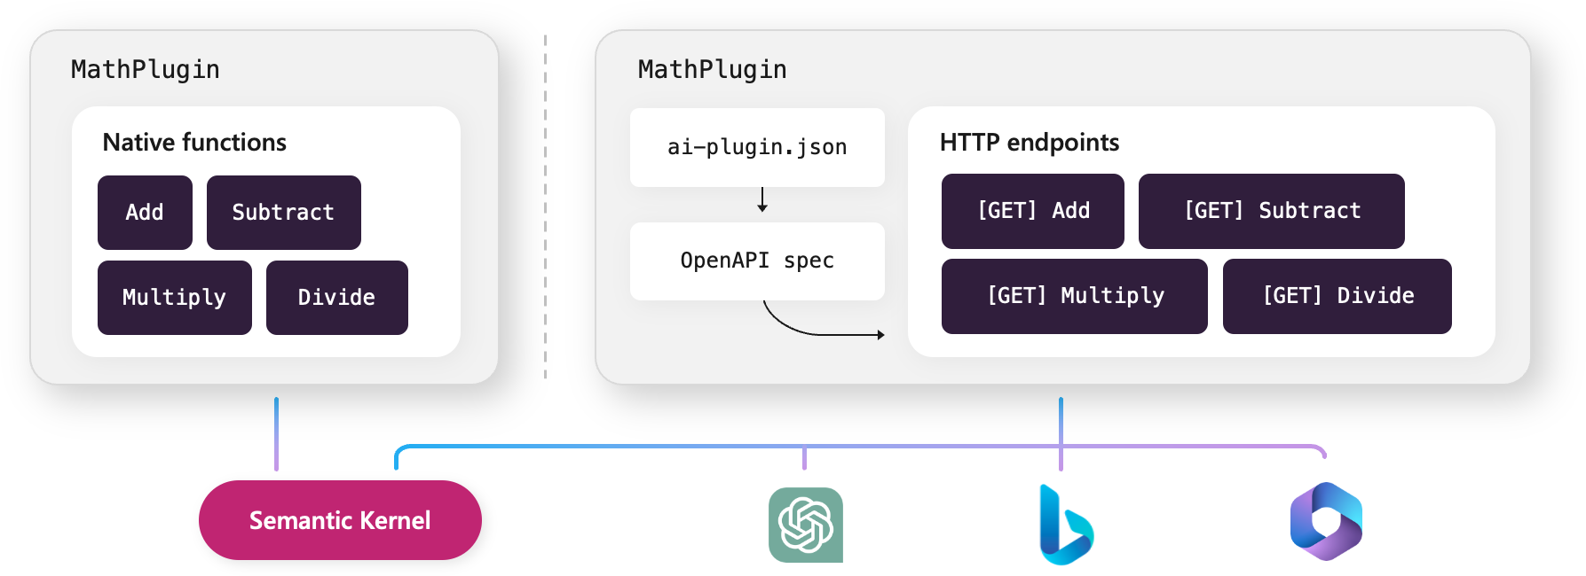
Native Function
There are two ways to add a plugin: local and remote
Semantic Function

Slide 13
Planners
The magic that combines plugins together to accomplish a user’s goal.

Slide 14
At the core of every copilot is a planner
The plan
Planners tell a Copilot what it should do next with the tools it has.
Action planner
Sequential planner
Custom Function Chaining
1
The planner
2
3

Slide 15
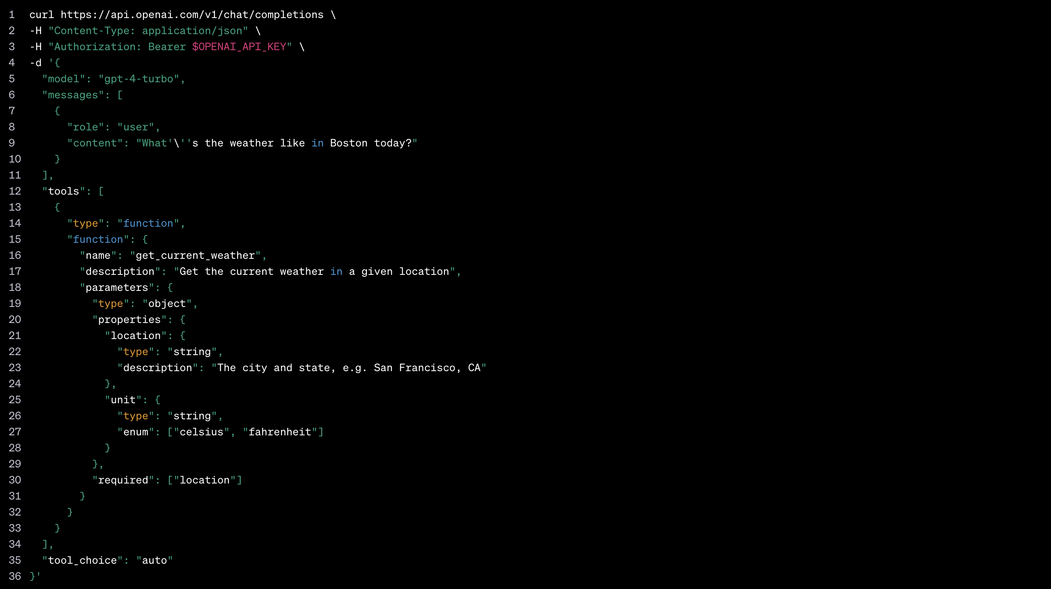
Planners have evolved since they were first introduced
Planners
V1 – Prompt based planners
V2 – Function calling
Create a series of steps that satisfy the user’s goal. Describe the series of steps using a custom JSON object. If you create the JSON incorrectly, there will be an error in the system, so don’t mess it up!
# Functions
class LightPlugin: def GetState(): pass def ChangeState(newState): pass
With function calling, there’s no planning prompt, you just give the AI model the list of the available functions using the provided API.

Slide 16
Planners
If the platform you’re using does not use function calling it will not perform as well as OpenAI’s GPTs.

Slide 17
When you use function calling, the model can return either a ”function call” or a message
Planners
Assistant
I’d love to help, but can you first provide the recipient, the subject, and the content of the email?
Please generate invoice for customer order and send an email the customer
Functions
- GenerateInvoice(Order)
- SendEmail(to, subject, body)
Assistant
SendEmail( matt@contoso.com, "Hello", ”Attached is your invoice” )

Slide 18
If the AI returns with a "function call", we need to actually invoke the function and return the result
Planners
Please create an email the customer
Assistant
Tool
SendEmail( matt@contoso.com, "Hello", ”How are you?” )
Invoke
Email sent
Functions
- GenerateInvoice()
- SendEmail(to, subject, body)

Slide 19
We then add the result back to the chat thread so the AI can respond back to the user.
Planners
Please create an email the customer
Assistant
Assistant
The email has been sent to the customer. Is there anything else that I can help you with today?
SendEmail( matt@contoso.com, "Hello", ”How are you?” )
Tool
Email sent
Functions
- GetWeather()
- SendEmail(to, subject, body)

Slide 20
Personas
Creating multi-agent experiences with Semantic Kernel.

Slide 21


Personas (agents) are just instructions (prompt) +plugins (function calling)
Coder agent
Instructions
Plugins
By combining a system prompt (i.e., instructions) with a set of plugins, you can recreate a “persona” that can complete user requests.
This mimics how “personas” in experience design have roles and tools to complete jobs-to-be-dones.
You are a python coder that can create classes and functions that address the user’s needs.
Python plugin
Doc plugin
Also called agents, copilots, GPTs, and assistants.

Slide 22
With plugins, you can have planners orchestrate other agents
Project Manager agent
Plugins
Researcher Agent
Mathematician Agent
Designer Agent

Slide 23
Copilot definition
Workshop
Let’s see how we can use plugins and planner
with SK to build our AI Assistant

Slide 24
Customer Use-Case
A Contoso company would like to build and AI Assistant for their non-technical business users to analyze their product sales data using natural language query. All the product sales data is stored in a SQL database and the business users does not know how to interact with the data using T-SQL and the company would really like to improve their productivity.
So, the company would like to build an AI Assistant to take a natural language input from the user, translate that user query into a T-SQL that can be run against the database to retrieve the data and use the LLM to summarize the results for the business users.

Slide 25
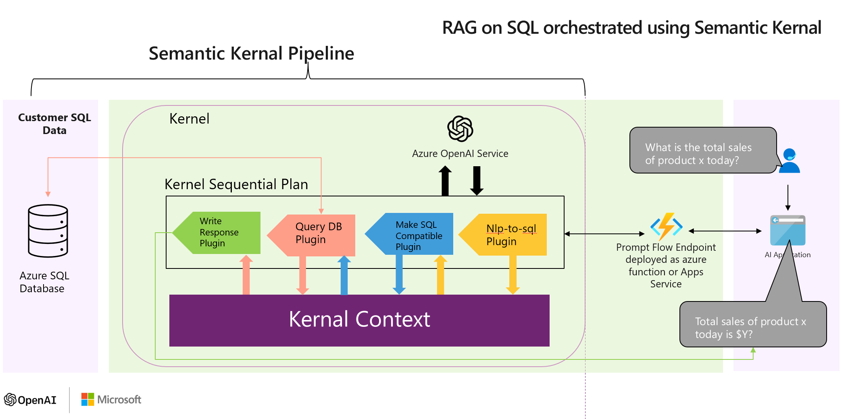
Solution Architecture

Slide 26
Copilot definition
Q&A

Slide 27
Copilot definition
Appendix

Slide 28
Refrences
Semantic Kernel documentation | Microsoft Learn
How to quickly start with Semantic Kernel | Microsoft Learn
Semantic Kernel | The latest news from the Semantic Kernel team for developers (microsoft.com)
Semantic Kernel Planner: Improvements with Embeddings and Semantic Memory | Semantic Kernel (microsoft.com)
https://microsoft.sharepoint.com/teams/semantic-kernel/SitePages/Repo.aspx
https://github.com/microsoft/semantic-kernel
https://learn.microsoft.com/en-us/semantic-kernel/overview/

Slide 29
LangChain & Semantic Kernel

Slide 30
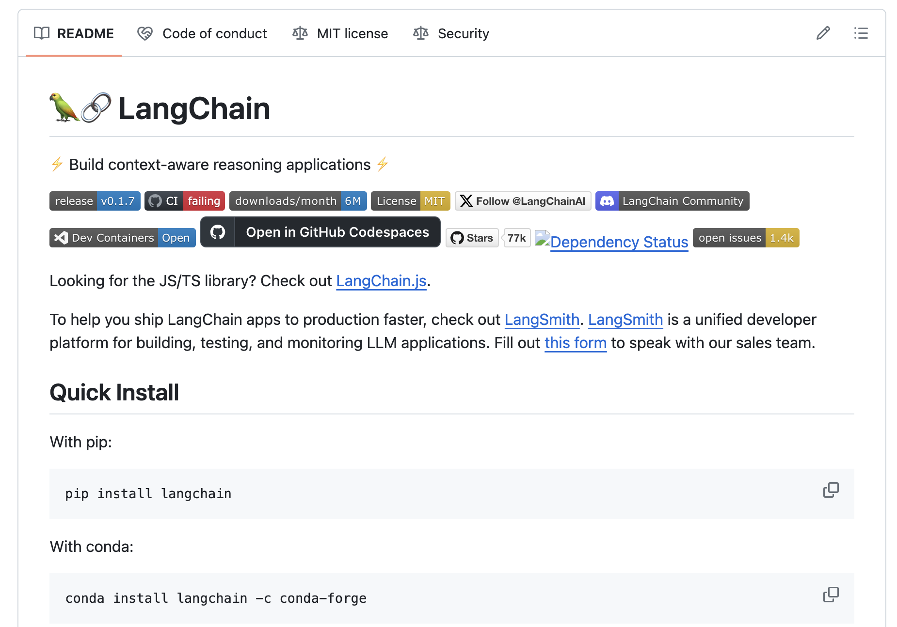
Supported languages
LangChain
How’s it different than LangChain?
Python (0.1.15)
TypeScript (0.1.32)
Java (0.29.1)

Slide 31
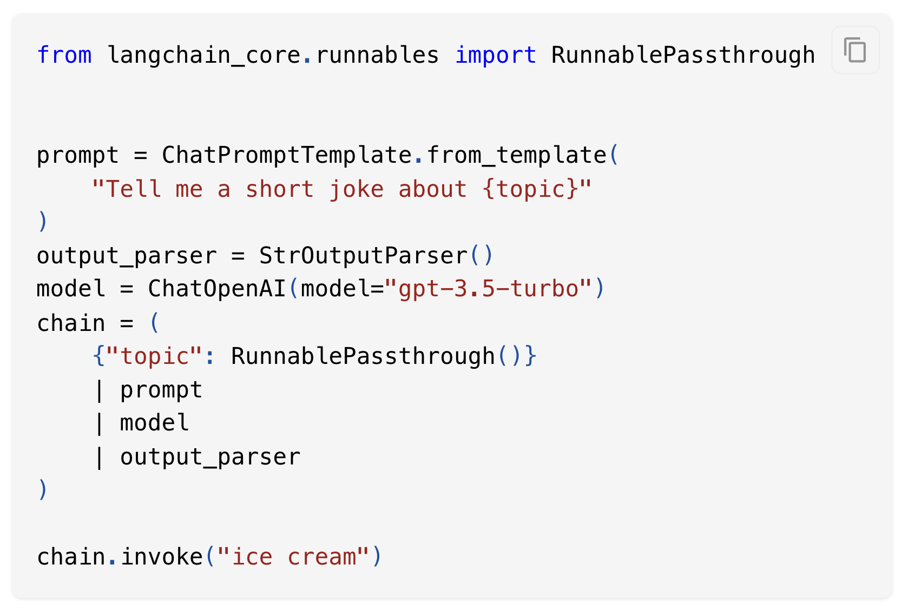
Supported languages
LangChain
At the core of LangChain are chains
Python (0.1.7)
TypeScript (0.1.18)
Java (0.27.1)
With chains, you pipe together elements (e.g., prompts, models, and parsers) before invoking it

Slide 32
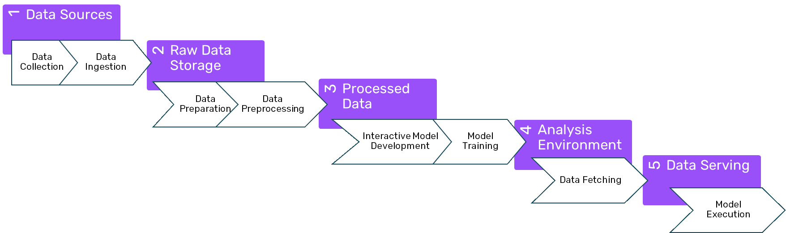
LangChain was built by and for AI researchers who have experience building AI data pipelines.
LangChain
Chains are familiar to them!

Slide 33
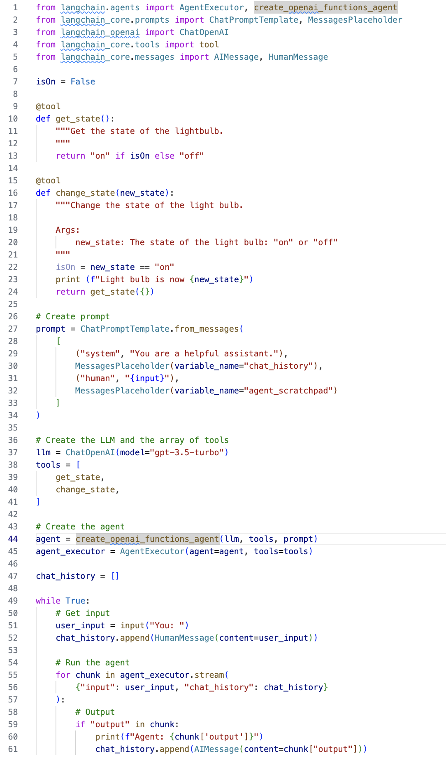
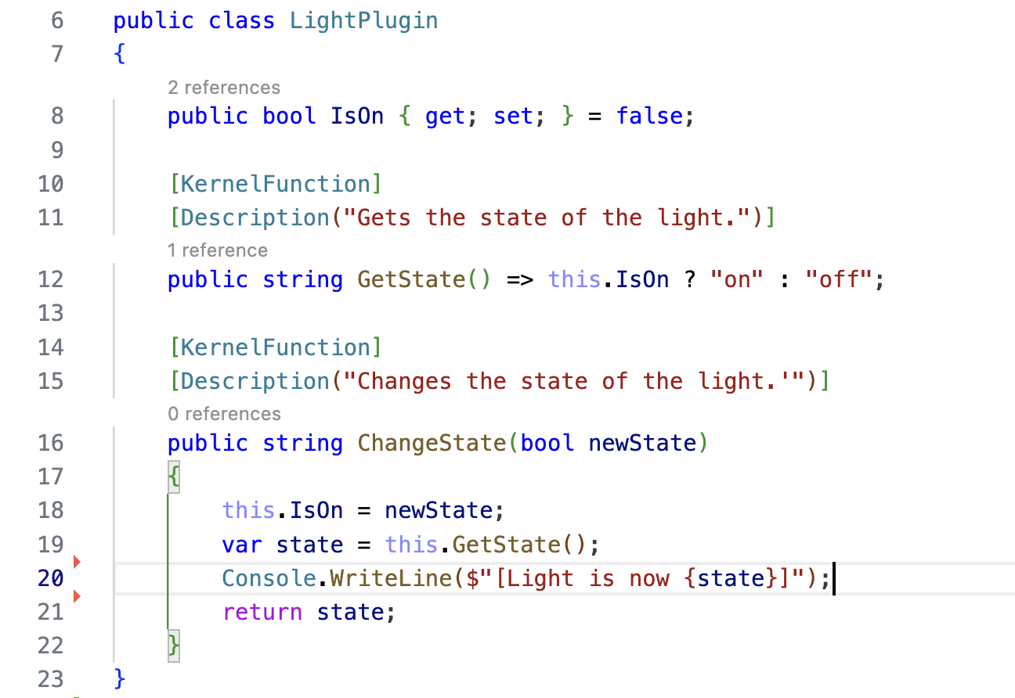
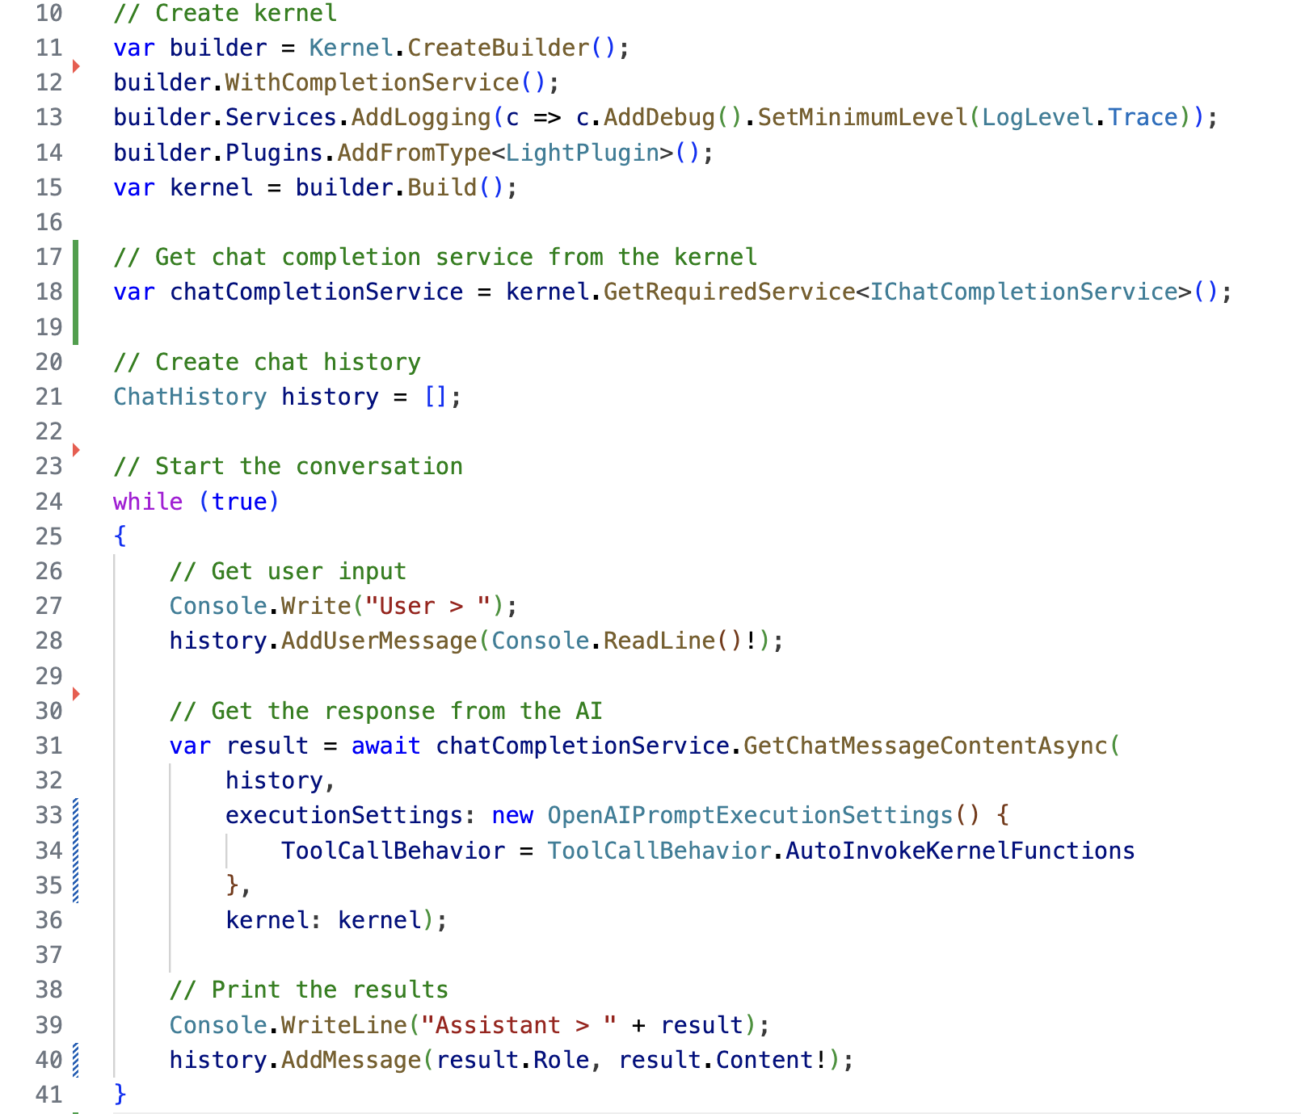
LangChain
Using LCEL
Semantic Kernel
V1.0.0

